Slide 1


Slide 2
BUSINESS CONTEXT

Slide 3
Kickoff agenda
Introduction (15min)
meet your new team
what’s the background?
why are we doing this?
Project (15min)
what are we doing?
    who is doing what?
how are we going to work together?
Q&A

Slide 4
Your dedicated team
eftsure Team
Kim Lalor Customer Success Manager kiml@eftsure.com.au
Greg Peignoux D365 Product Manager gregp@eftsure.com.au
Berengere Villey D365 Finance Expert berengerep@eftsure.com.au

Slide 5
Implementing eftsure inside D365 F&O
Congratulations on purchasing eftsure inside D365 F&O
What do we do now?
Deployments
Training
VMF Verification
Go Live
Support
How?
Answers:
TimeLine/GoLive,
Stakeholders
Onboarding workflows

Slide 6
Implementing eftsure inside D365 F&O
Implementations can vary by multiple factors:
Size of VMF
Number of users
Segregation of duties
Design of onboarding forms
Complexity of processes
Additonal customisations
Features to enable:
Vendor collaboration,
ABR integration
Workflows
Integrations

Slide 7
Implementing eftsure inside D365 F&O
Tools available to help you Go Live successfully
Project management & Gantt charts
Change management
Documentation
Videos

Slide 8
PROJECT DEMO

Slide 9
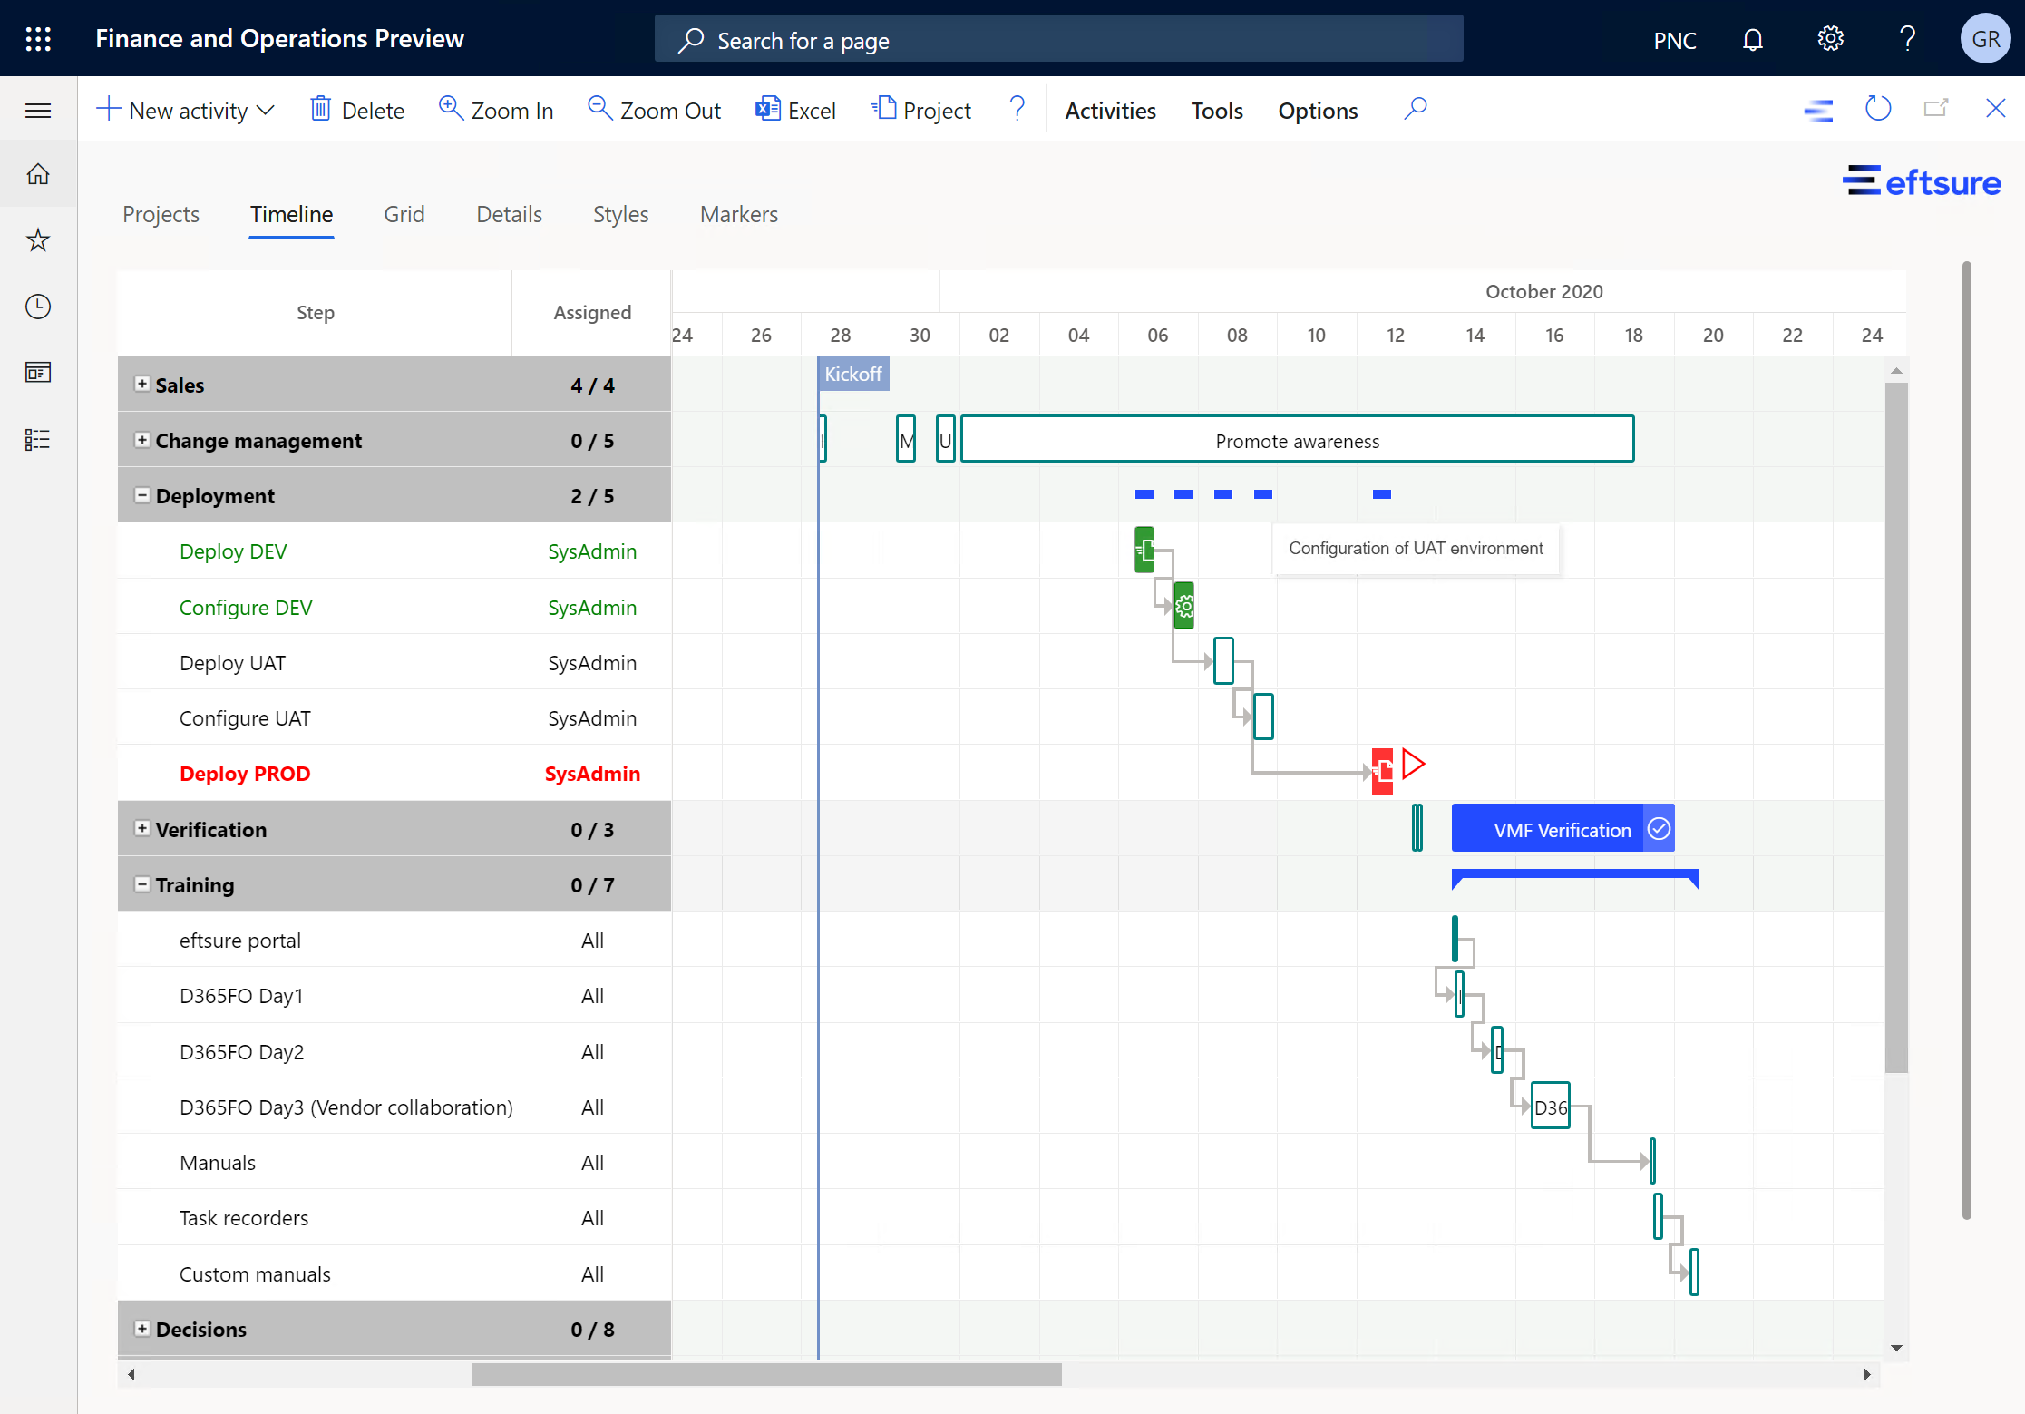
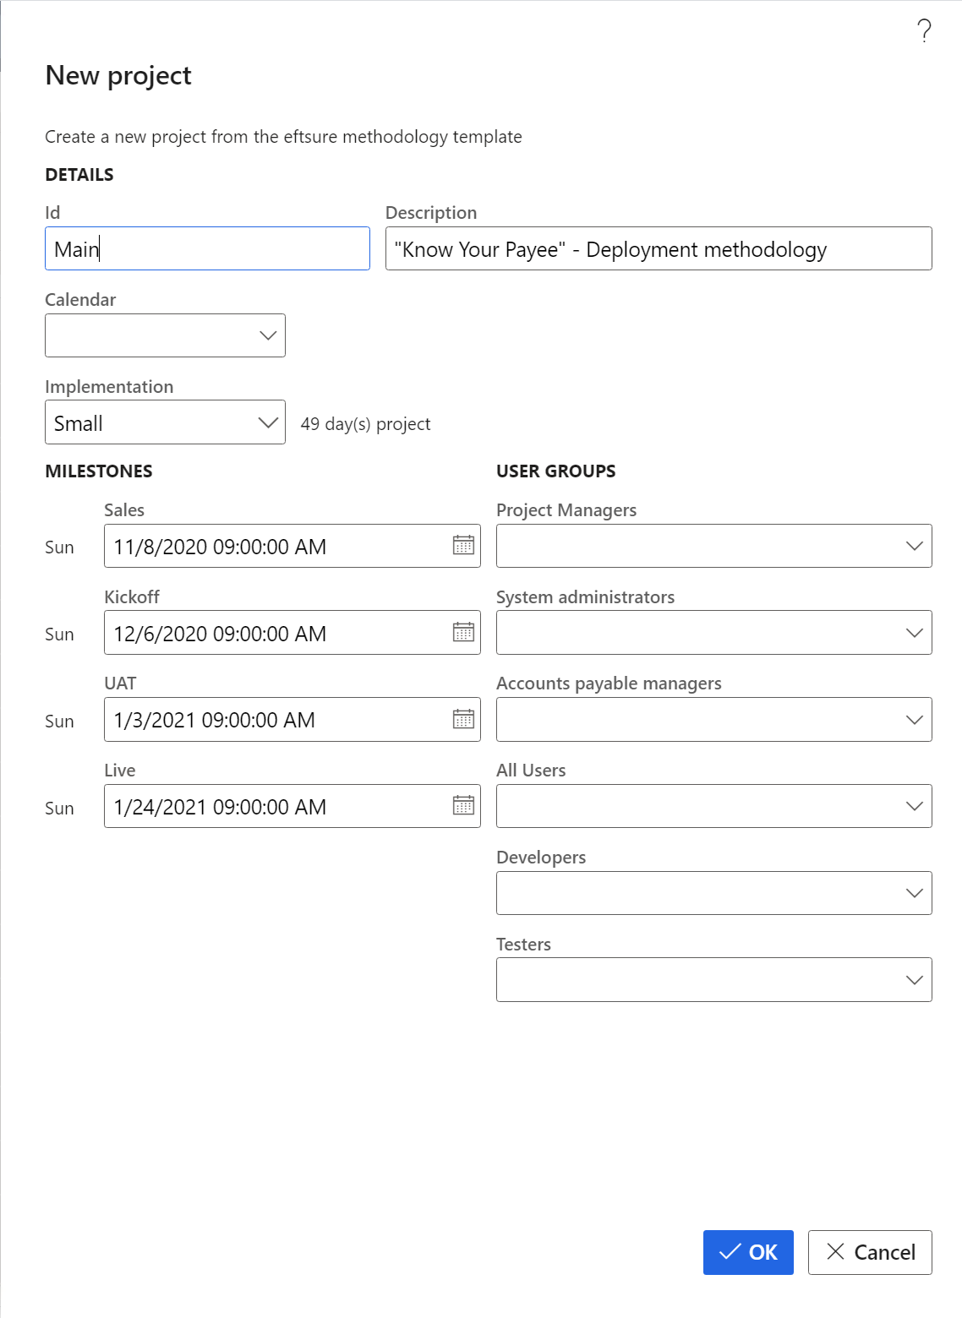
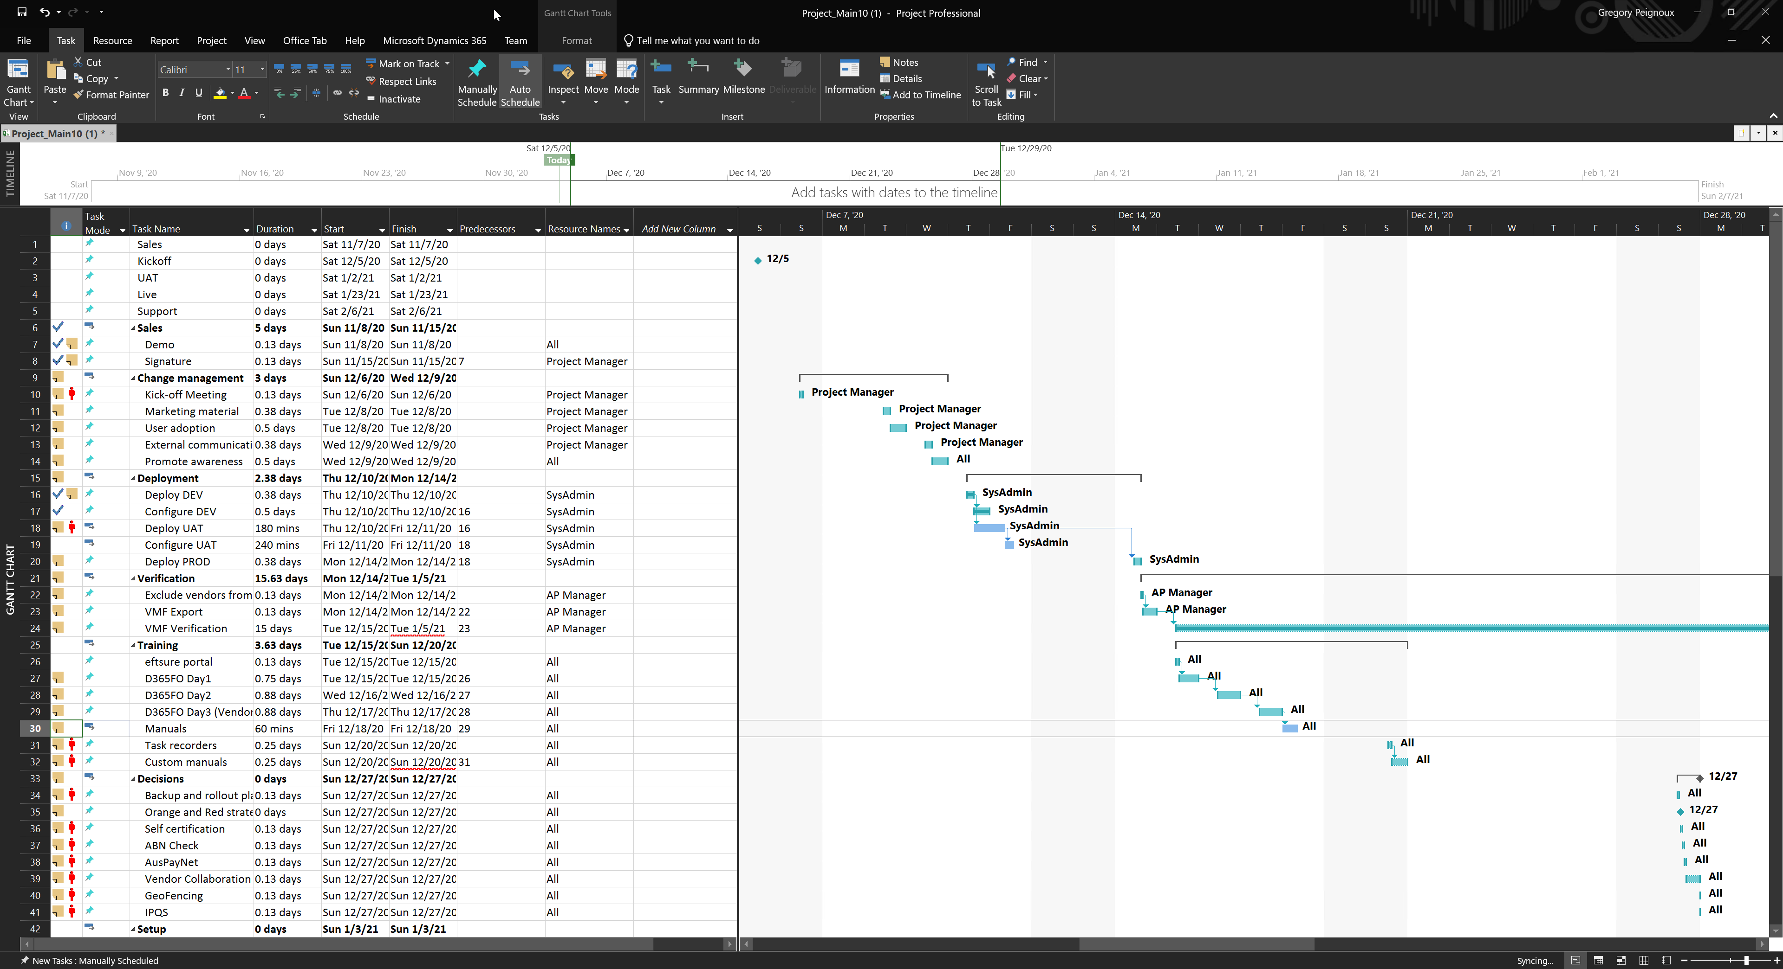
Demo

Slide 10
Demo
Project dashboard
Creating a new project
Managing a project in eftsure inside D365F&O
Managing a project in Microsoft Project
My tasks on the project(s)

Slide 11
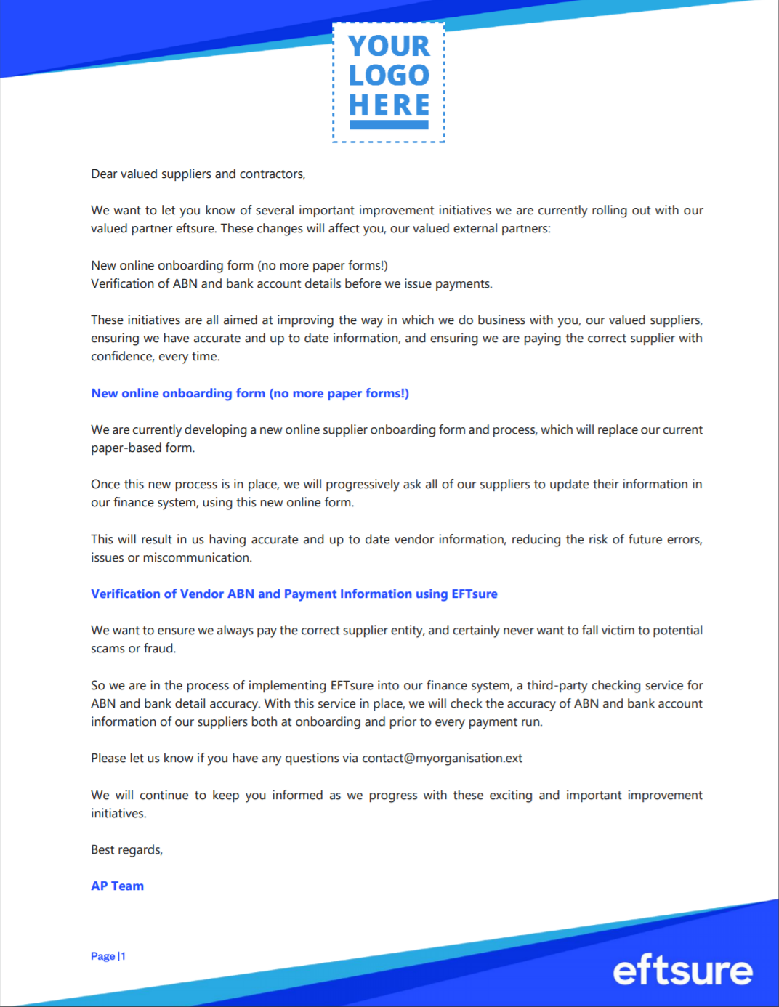
External communication
Warn your suppliers early that change is coming
Communicating with your suppliers early is key to a smooth integration into your processes.
Reuse the External Communication Sample email to spread the word on the upcoming changes for your organization.

